Slide 1
R Shiny for Operations and GIS
Instructor: Geoffrey Arnold

Slide 2
About the Instructor
Education:
University of Pittsburgh: BA Political Science & History 2010
Heinz College: MS PPM 2015
Professional:
PA State Democratic Party: Field Organizer 2010
City Year Greater Philadelphia: Senior Corps Leader: 2011-2012
Lutheran Child & Family Services: Group Leader 2013
City of Pittsburgh: Performance Improvement Analyst 2015-2017

Slide 3
Schedule
House keeping
Basic Concepts of Shiny Apps
Shiny Dashboards
Input Widgets & Reactivity
Update Inputs & More
Shiny & Rmarkdown
shinyapps.io

Slide 4
House keeping
Section 1

Slide 5
Course Documents
goo.gl/htq1GE
Includes
In class example blank templates
Completed Version of the final apps
This power point presentation
Download files to a single folder on your laptop.

Slide 6
R Projects
Projects let us easily get back to whatever state we were working in on, not just for shiny apps.
Open a new project:
File
New Project
Existing Directory - Select the location you saved all of the google drive files

Slide 7
Examples
App
https://gallery.shinyapps.io/lego-viz/
Shiny Dashboard
https://gallery.shinyapps.io/087-crandash/
Flexdashboard
https://pittsburghpa.shinyapps.io/dashburgh/
Map:
https://pittsburghpa.shinyapps.io/BurghsEyeView

Slide 8
Basic Concepts of Shiny apps
Section 2

Slide 9
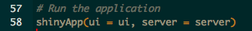
Two Basic Parts of the function
UI – User Interface
Builds the webpage
Can be done in R code OR HTML
Server
Generates all reactive content
Can be used to change portions of UI

Slide 10
The User Interface
UI

Slide 11
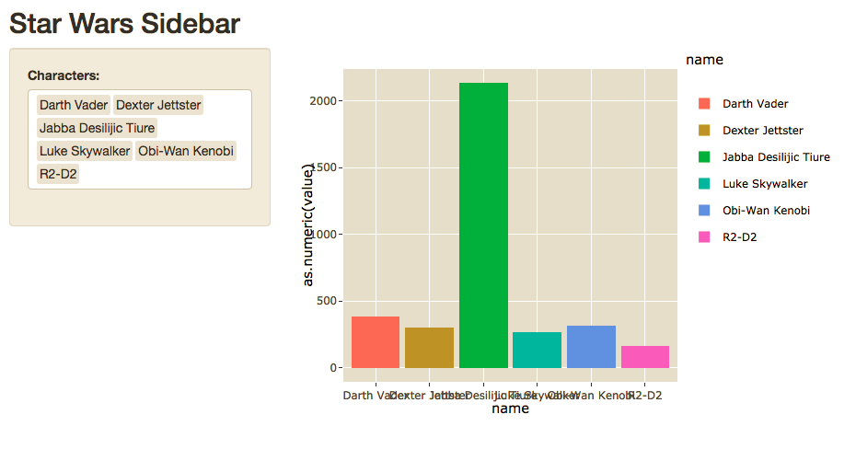
Sidebar Layout

Slide 12
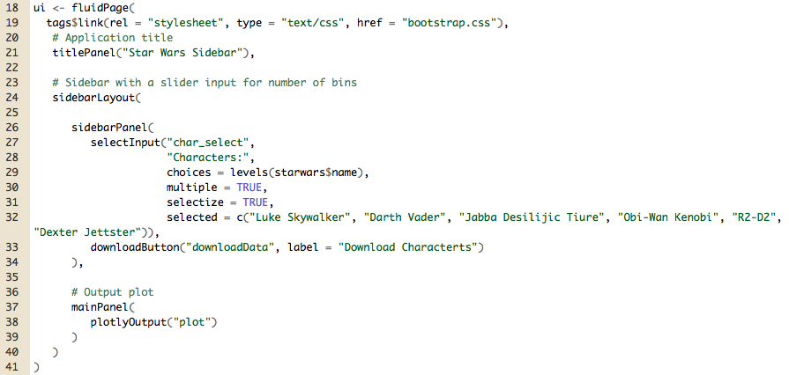

Slide 13
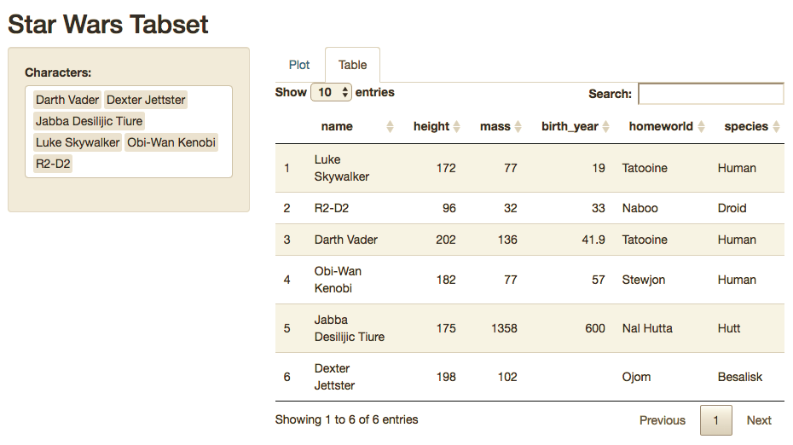
Sidebar w/ Tabset

Slide 14
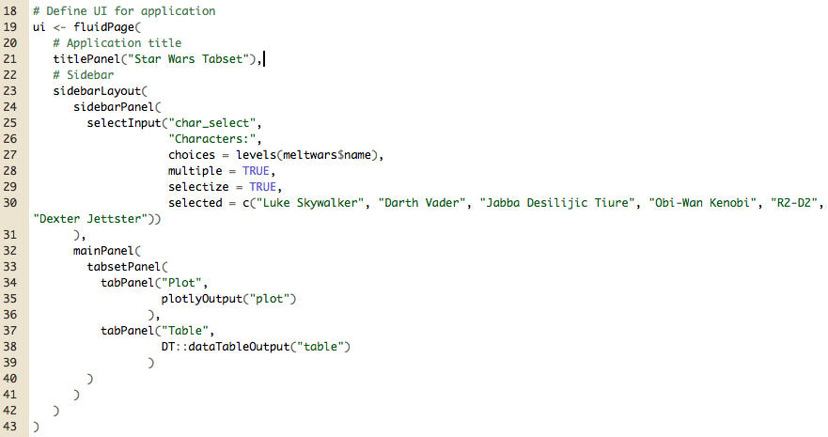

Slide 15
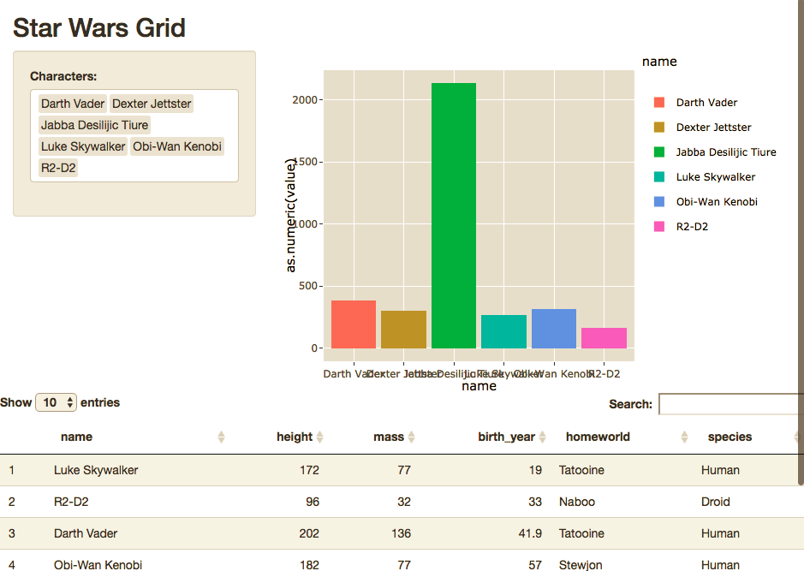
Grid

Slide 16
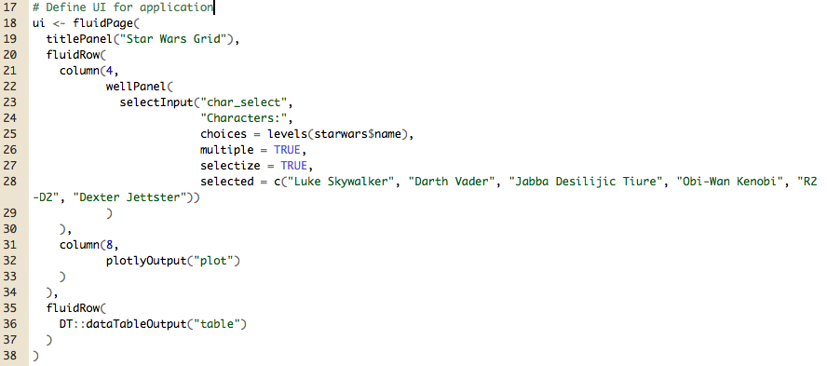

Slide 17
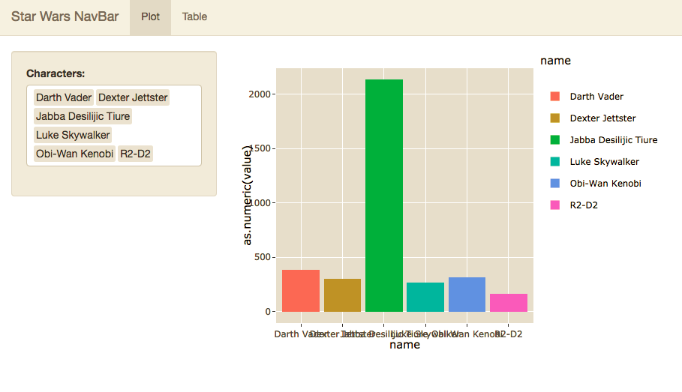
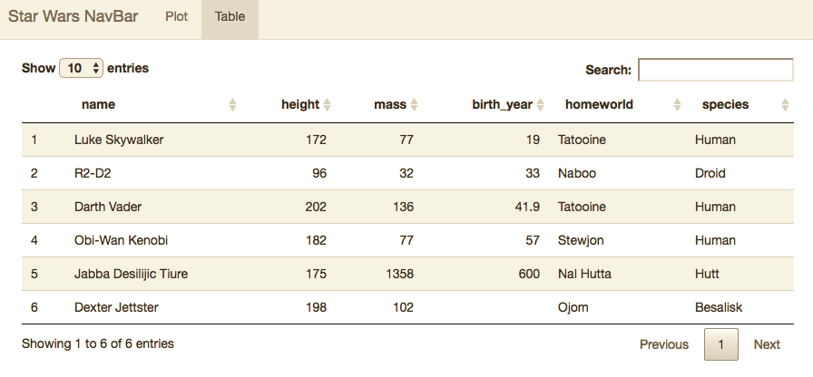
NavBar

Slide 18
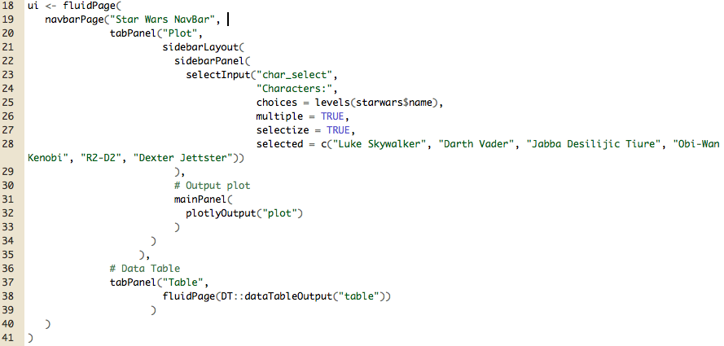

Slide 19
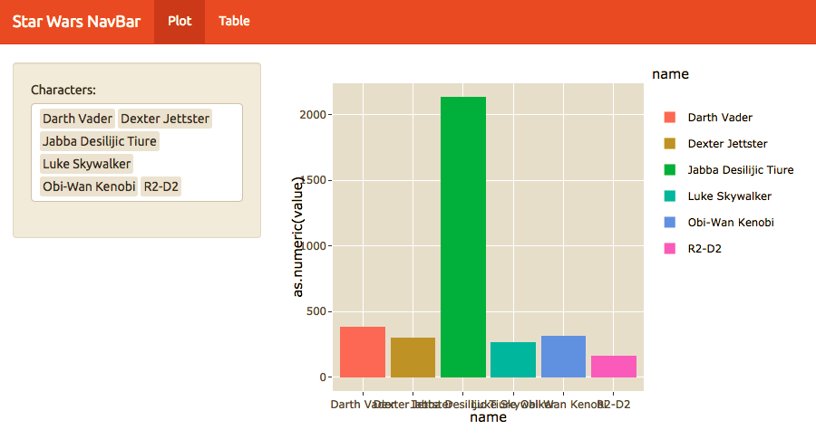
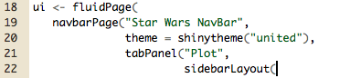
Custom Theme

Slide 20
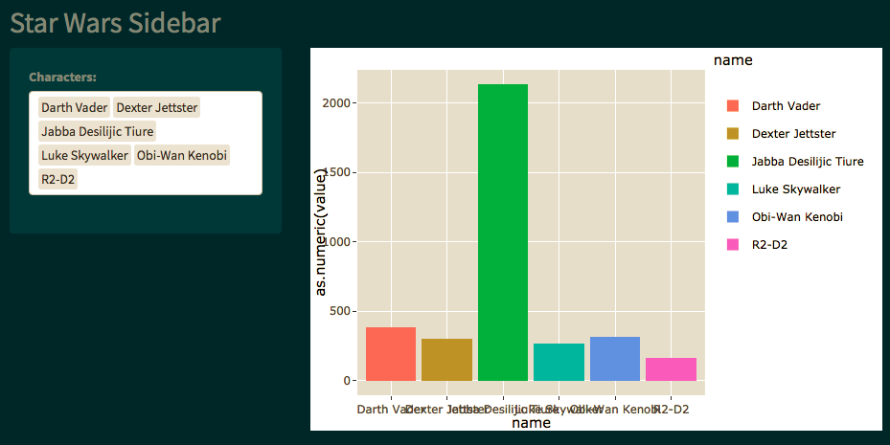
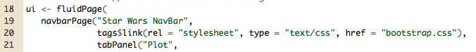
Custom Themes

Slide 21
Input WidgetS
https://shiny.rstudio.com/gallery/widget-gallery.html
Section 4

Slide 22
The Server Function

Slide 23
Server Function
Outputs
List of functions called in the UI which generates plots, tables and other objects.
Will regenerate whenever dependent inputs are changed, or based off of required action in UI.
Shiny Apps will display from any graphics package including;
ggplot2
plotly
DT
LeafletR
googleVis
wordcloud2
ggmap

Slide 24
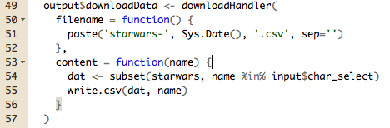
Calling Outputs
Output is a list which you build onto as you create your visuals
Each entry in the list is called in the UI by the name saved.
Example:

Slide 25
How do Input Widgets Work?
Inputs are sent to the server function as a list.
Each are called by input$inputId
Value and length of the input depends on the widget
Inputs can even be entire files, images, urls etc.

Slide 26
Numeric Inputs

Slide 27
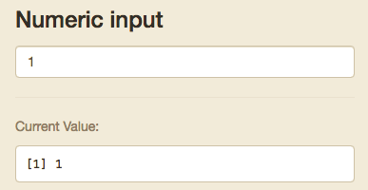
Numeric Input
Goes up and down based off clicks
Stored as single numeric input

Slide 28
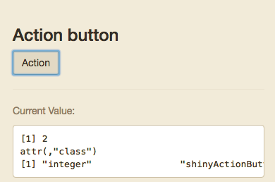
Action Button
+1 each time it is clicked
Stored as single numeric input

Slide 29
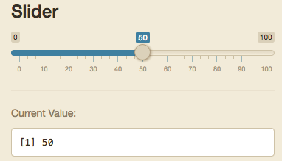
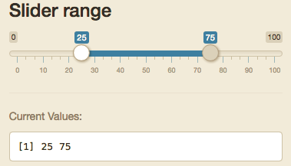
Slider/Range
Either a single integer or list of 2 called separately by input$“inputId”[1] and input$“inputId”[2]

Slide 30
Text Inputs

Slide 31
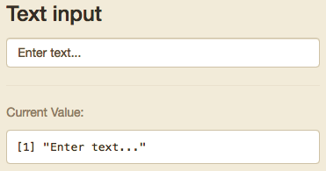
Text Input
Can be tied to action button or enter to initialize input.

Slide 32
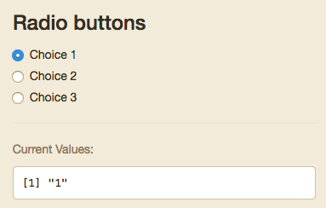
Radio Buttons
Only one option
Value can be dictated in your code, but will default to the value of the text in the choices field

Slide 33
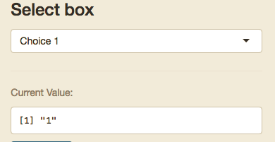
Select input
Can be set to only one selected option or multiple
Value can be dictated in your code, but will default to the value of the text in the choices field
Stored either as a single object or as a list

Slide 34
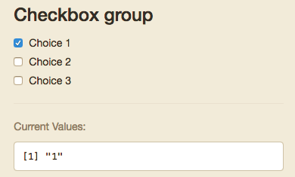
Checkbox Group
Multiple can be selected
Value can be dictated in your code, but will default to the value of the text in the choices field
Stored either as a single object or as a list

Slide 35
Other Inputs

Slide 36
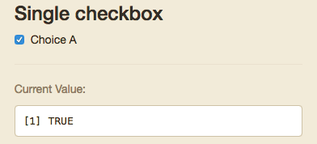
Single Checkbox
Boolean

Slide 37
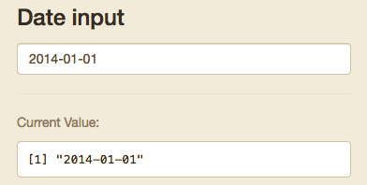
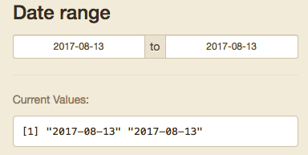
Date/Range
Either a single integer or list of 2 called separately by input$“inputId”[1] and input$“inputId”[2]
R will see these as Dates

Slide 38
Single Checkbox
Boolean

Slide 39
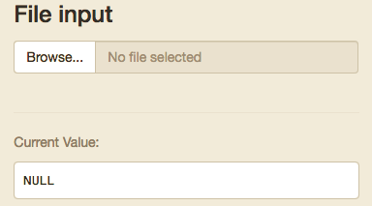
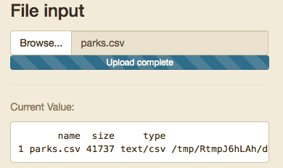
File Input
You should make sure your code checks the format and end of the file
All input references:
https://shiny.rstudio.com/tutorial/written-tutorial/lesson3/

Slide 40
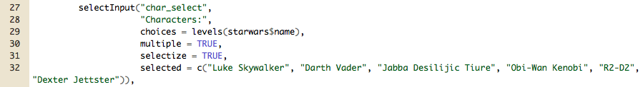
How are inputs stored?
Inputs are stored as a list of lists
For example:
Below the input is called using: input$char_select
Since multiple values can be selected, it has a length equal to the number of characters selected.
input$char_select[1] returns “Luke Skywalker”
Therefore A date range or two sided slide bar input is always a length 2

Slide 41
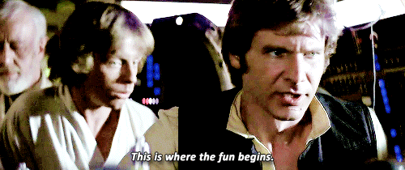
Practice
SideBar - Blank

Slide 42
Shiny Dashboards
Section 3

Slide 43
Basic Layout
Dashboards are broken into a single argument made up of three arguments
Header – Window title as well as Menus
Sidebar – Sidebar for navigating Dashboard tabs and can hold global selection inputs
Body – Where the magic happens.

Slide 44
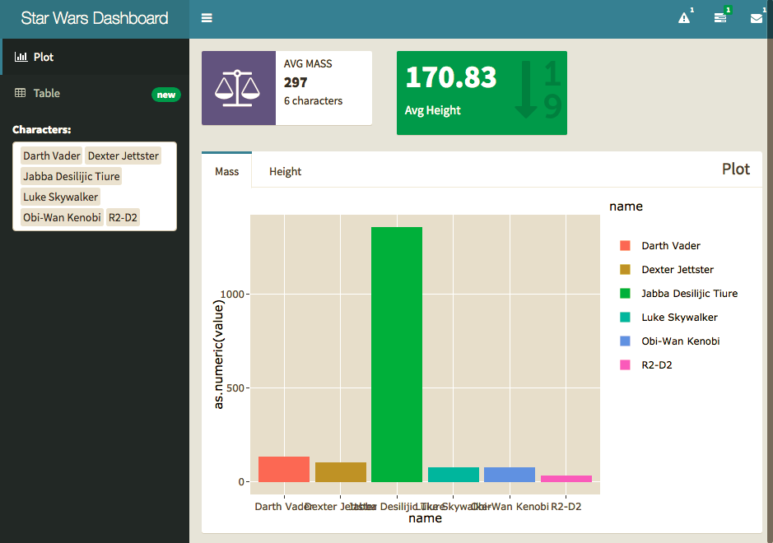

Slide 45
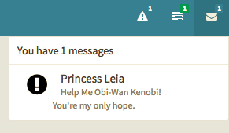
Headers

Slide 46
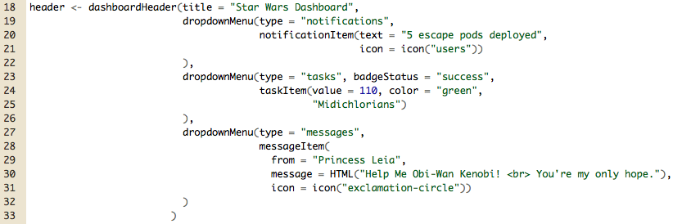
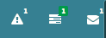
Options
Notifications
Tasks
Messages

Slide 47
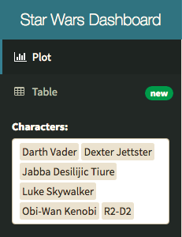
Sidebar

Slide 48
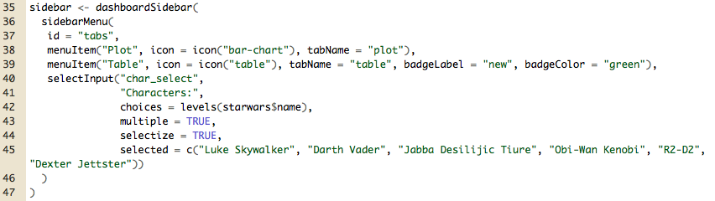
Menu Items – tabName referenced in body.
Global Inputs – Should work on all tabs and for all visuals.

Slide 49
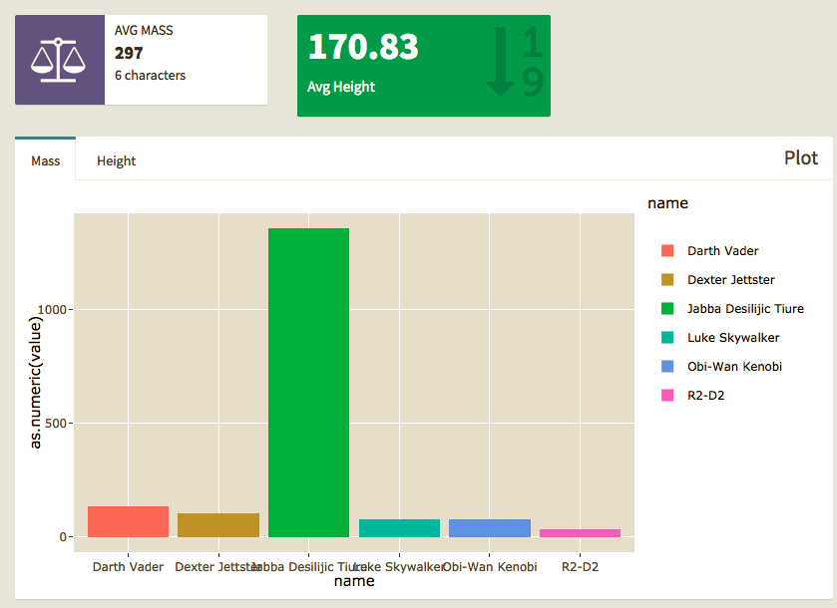
Body

Slide 50
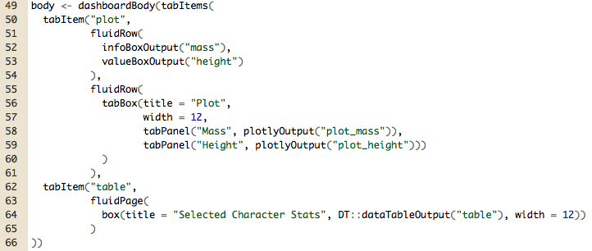
Tab Items – by name in Menu
Row\Page – based layouts
Box – All contents should go in a box
Page is broken into 12 equal bars. Width can be 1-12
If 12+ is specified content will kick to new row automatically, anything unspecified will get squished.
Inputs – can also go in boxes here should be clear what visuals they work with.

Slide 51
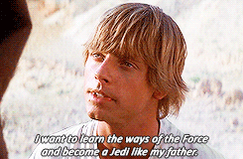
practice
Dashboard - Blank

Slide 52
Break

Slide 53
Output Based Inputs

Slide 54
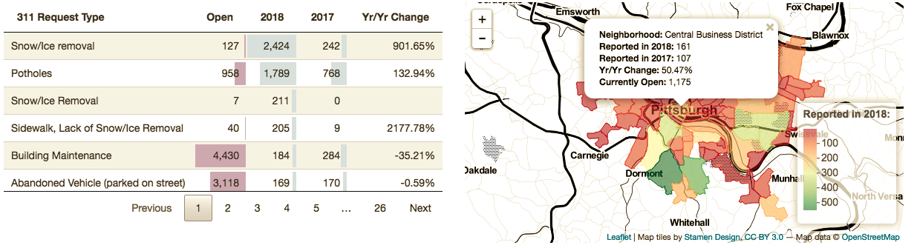
Data Table
The DT::datatable outputs has many inputs you can use to control other plots or outputs.
Before

Slide 55
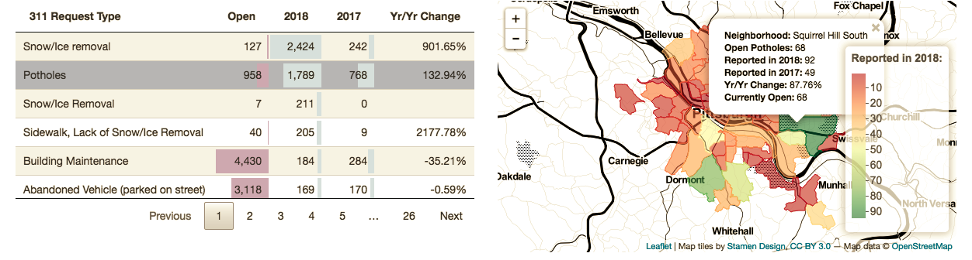
Data Table
The DT::datatable outputs has many inputs you can use to control other plots or outputs.
After

Slide 56
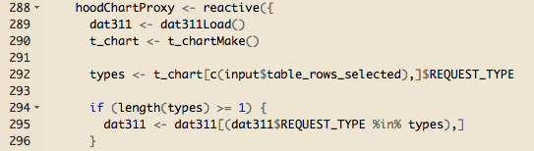
Data Table
The DT::datatable outputs has many inputs you can use to control other plots or outputs.

Slide 57
reactive

Slide 58
Everything in R is a Function
Reactive Datasets are a functions you can call whenever you need a set of actions to occur based off of filters in your application
They should be used whenever you are using the same inputs/filters on the same data for multiple outputs/visuals.
You can call reactive functions within other reactive functions for simple
These go in the server function/files
They are called as any function but with no arguments
Caches results to speed up loading
Ensures your visuals are all showing the same information
Shorter more legible code

Slide 59
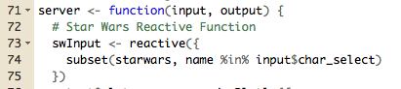
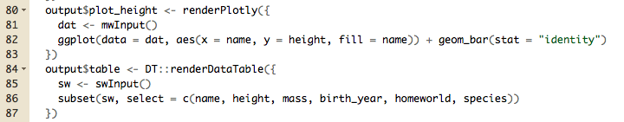
Reactive Example
Using our Shiny Dashboard from last week we have a bunch of plots and info boxes using the same data and filters.
If we add reactive functions we can call the filtered data automatically in each output.

Slide 60
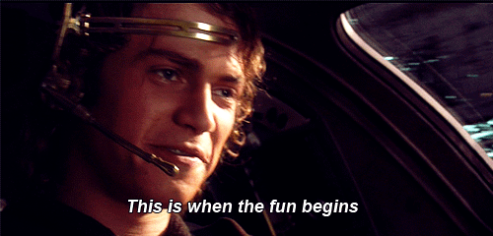
Practice
Dashboard - Blank

Slide 61
Update inputs and more
Section 5

Slide 62
Updates

Slide 63
Updates & Observe Events
Any time you wish to update part of your UI you will need to include an event observer.
Here you will be observing an input that your user can interact with
Observers can be done in one of two ways. Event observers or generic observer function
observeEvent() when you are observing a particular input
observe() works if you want to observe multiple things, or non-input based object such as the output or content of a reactive function.

Slide 64
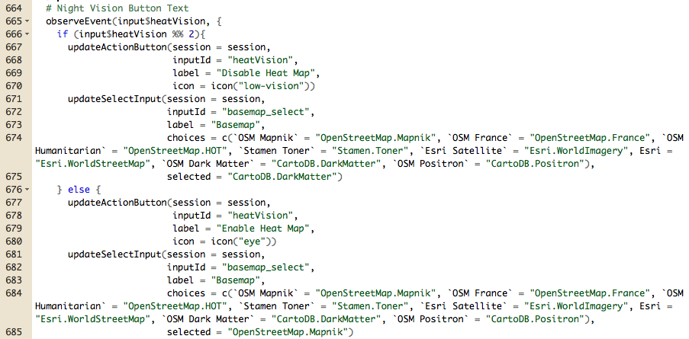

Slide 65
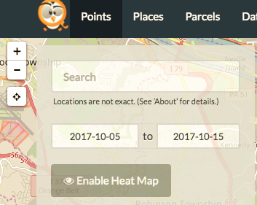
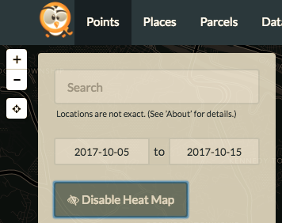
Before: After:

Slide 66
Notifications

Slide 67
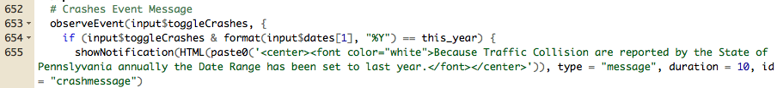
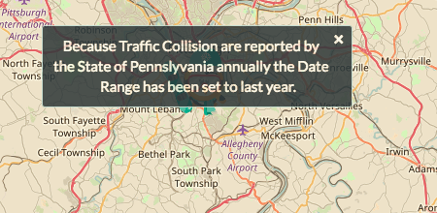
Notification Example

Slide 68
Bookmarking

Slide 69

Bookmarking Example

Slide 70
Progress Bars

Slide 71

Progress Bar Example

Slide 72
Shiny & RMarkdown
Section 6

Slide 73
Flexdashboards

Slide 74
Flex Dashboard
All code is handled within the Markdown Style
You can embed standalone shiny apps, or use elements from the dashboard at large.
More limited structure than shiny apps, but…
It’s easier
Looks nicer
No server/output issues, its all handled in the background

Slide 75

Setup
Other options
Logo
NavBar Icons
Embed Code
Sharing Links
Custom CSS file

Slide 76

Global Sidebar

Slide 77

Page Sidebar

Slide 78

Side Bar

Slide 79

Value Box

Slide 80

Value Box

Slide 81

Gauge

Slide 82

Gauge

Slide 83

Plot

Slide 84


Slide 85

Tabbed Row

Slide 87

Data Table

Slide 88


Slide 89

Practice
Flexdashboard - Blank

Slide 90
Flexdashboard: Storyboard

Slide 91

Setup

Slide 92

Basic Board Page

Slide 93

Practice
Storyboard - Blank

Slide 94
Shiny Apps.io
http://www.shinyapps.io/
Section 6

Slide 95


Register a free Account

Slide 96


Connect your account

Slide 97

Publish one of todays apps!

Slide 98

Practice

Slide 99

Thank you

